Slide 1
Logistic Regression

Slide 2
Logistic Regression
Logistic regression models the probabilities for classification problems with two possible outcomes.
Logistic Regression is used when the dependent variable(target) is categorical.
For example,
To predict whether an email is spam (1) or (0)
Whether the tumor is malignant (1) or not (0)

Slide 3
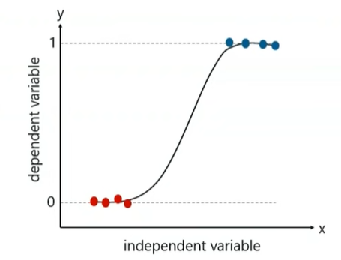
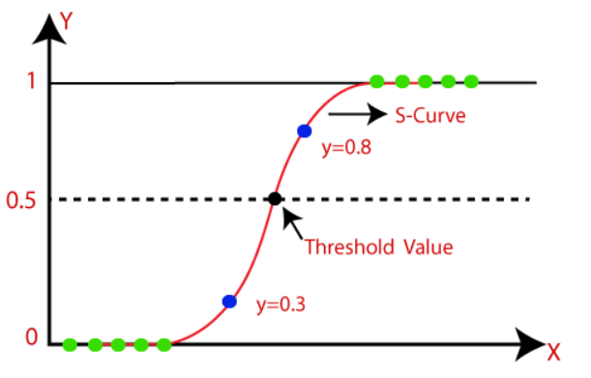
Logistic Regression
Logistic regression can be used to classify an observation into one of two classes (like ‘positive sentiment’ and ‘negative sentiment’), or into one of many classes.
In Logistic regression, instead of fitting a regression line, we fit an "S" shaped logistic function, which predicts two maximum values (0 or 1).

Slide 4
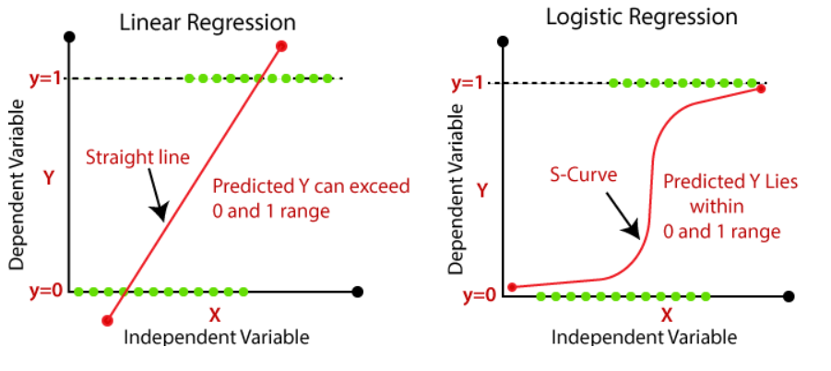


Linear Regression Vs Logistic Regression
The predicted value gets converted into probability by feeding it to the sigmoid function.
The equation of sigmoid:
Or

Slide 5
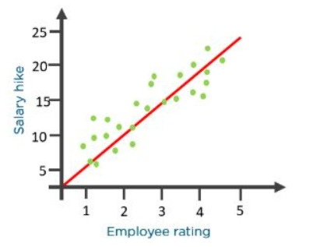
Logistic Regression Algorithm
For example, An organization wants to determine an employee’s salary increase based on their performance.
A linear regression algorithm will help them decide.
what if the organization wants to know whether an employee would get a promotion or not based on their performance

Slide 6
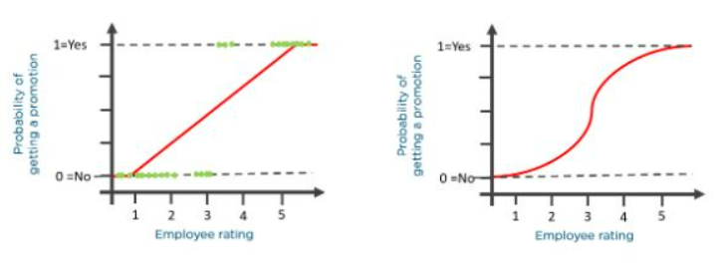
Logistic Regression Algorithm
The linear graph won’t be suitable in such case. As such, we clip the line at zero and one and convert it into a sigmoid curve (S curve).

Slide 7
To understand logistic regression, let’s go over the odds of success.
Odds (𝜃) = Probability of an event happening / Probability of an event not happening
𝜃 = p / 1 - p
The values of odds range from zero to ∞ and the values of probability lie between zero and one.

Slide 8

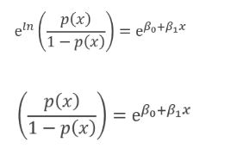


Consider the equation of a straight line:
𝑦 = 𝛽0 + 𝛽1* 𝑥
Now to predict the odds of success, we use the following formula:
Exponentiating both the sides, we have:

Slide 9


Classification with Logistic Regression
The sigmoid function from the prior section thus gives us a way to take an instance x and compute the probability P(y = 1|x).
The decision boundary:
The equation for logistic regression is:

Slide 10
Types of Logistic Regression
1. Binary Logistic Regression
The categorical response has only two 2 possible outcomes. Example: Spam or Not
2. Multinomial Logistic Regression
Three or more categories without ordering. Example: Predicting which food is preferred more (Veg, Non-Veg, Vegan)
3. Ordinal Logistic Regression
Three or more categories with ordering. Example: Movie rating from 1 to 5

